Slide 1
3.1 Computer architecture
Von Neumann architecture

Slide 2
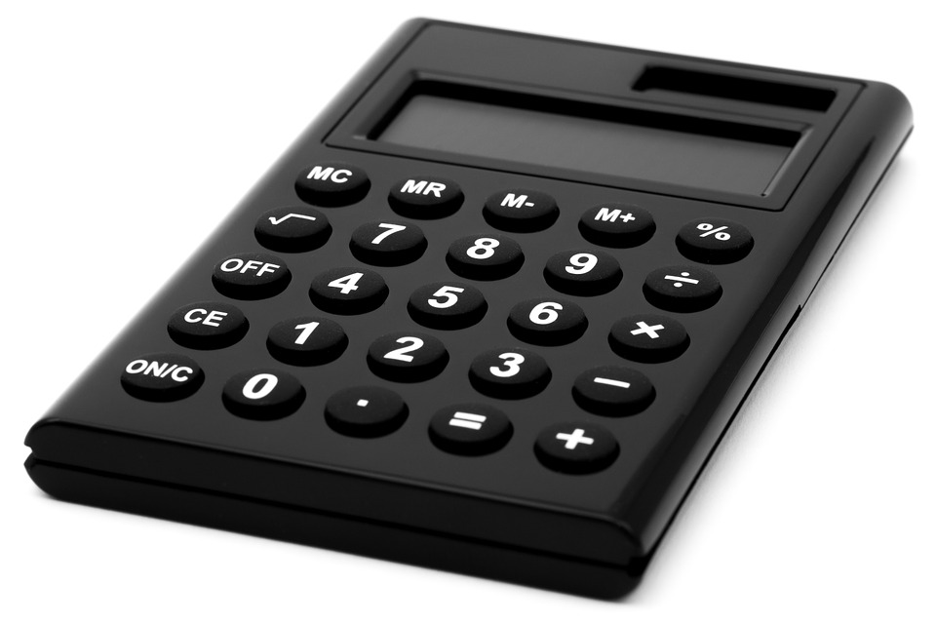
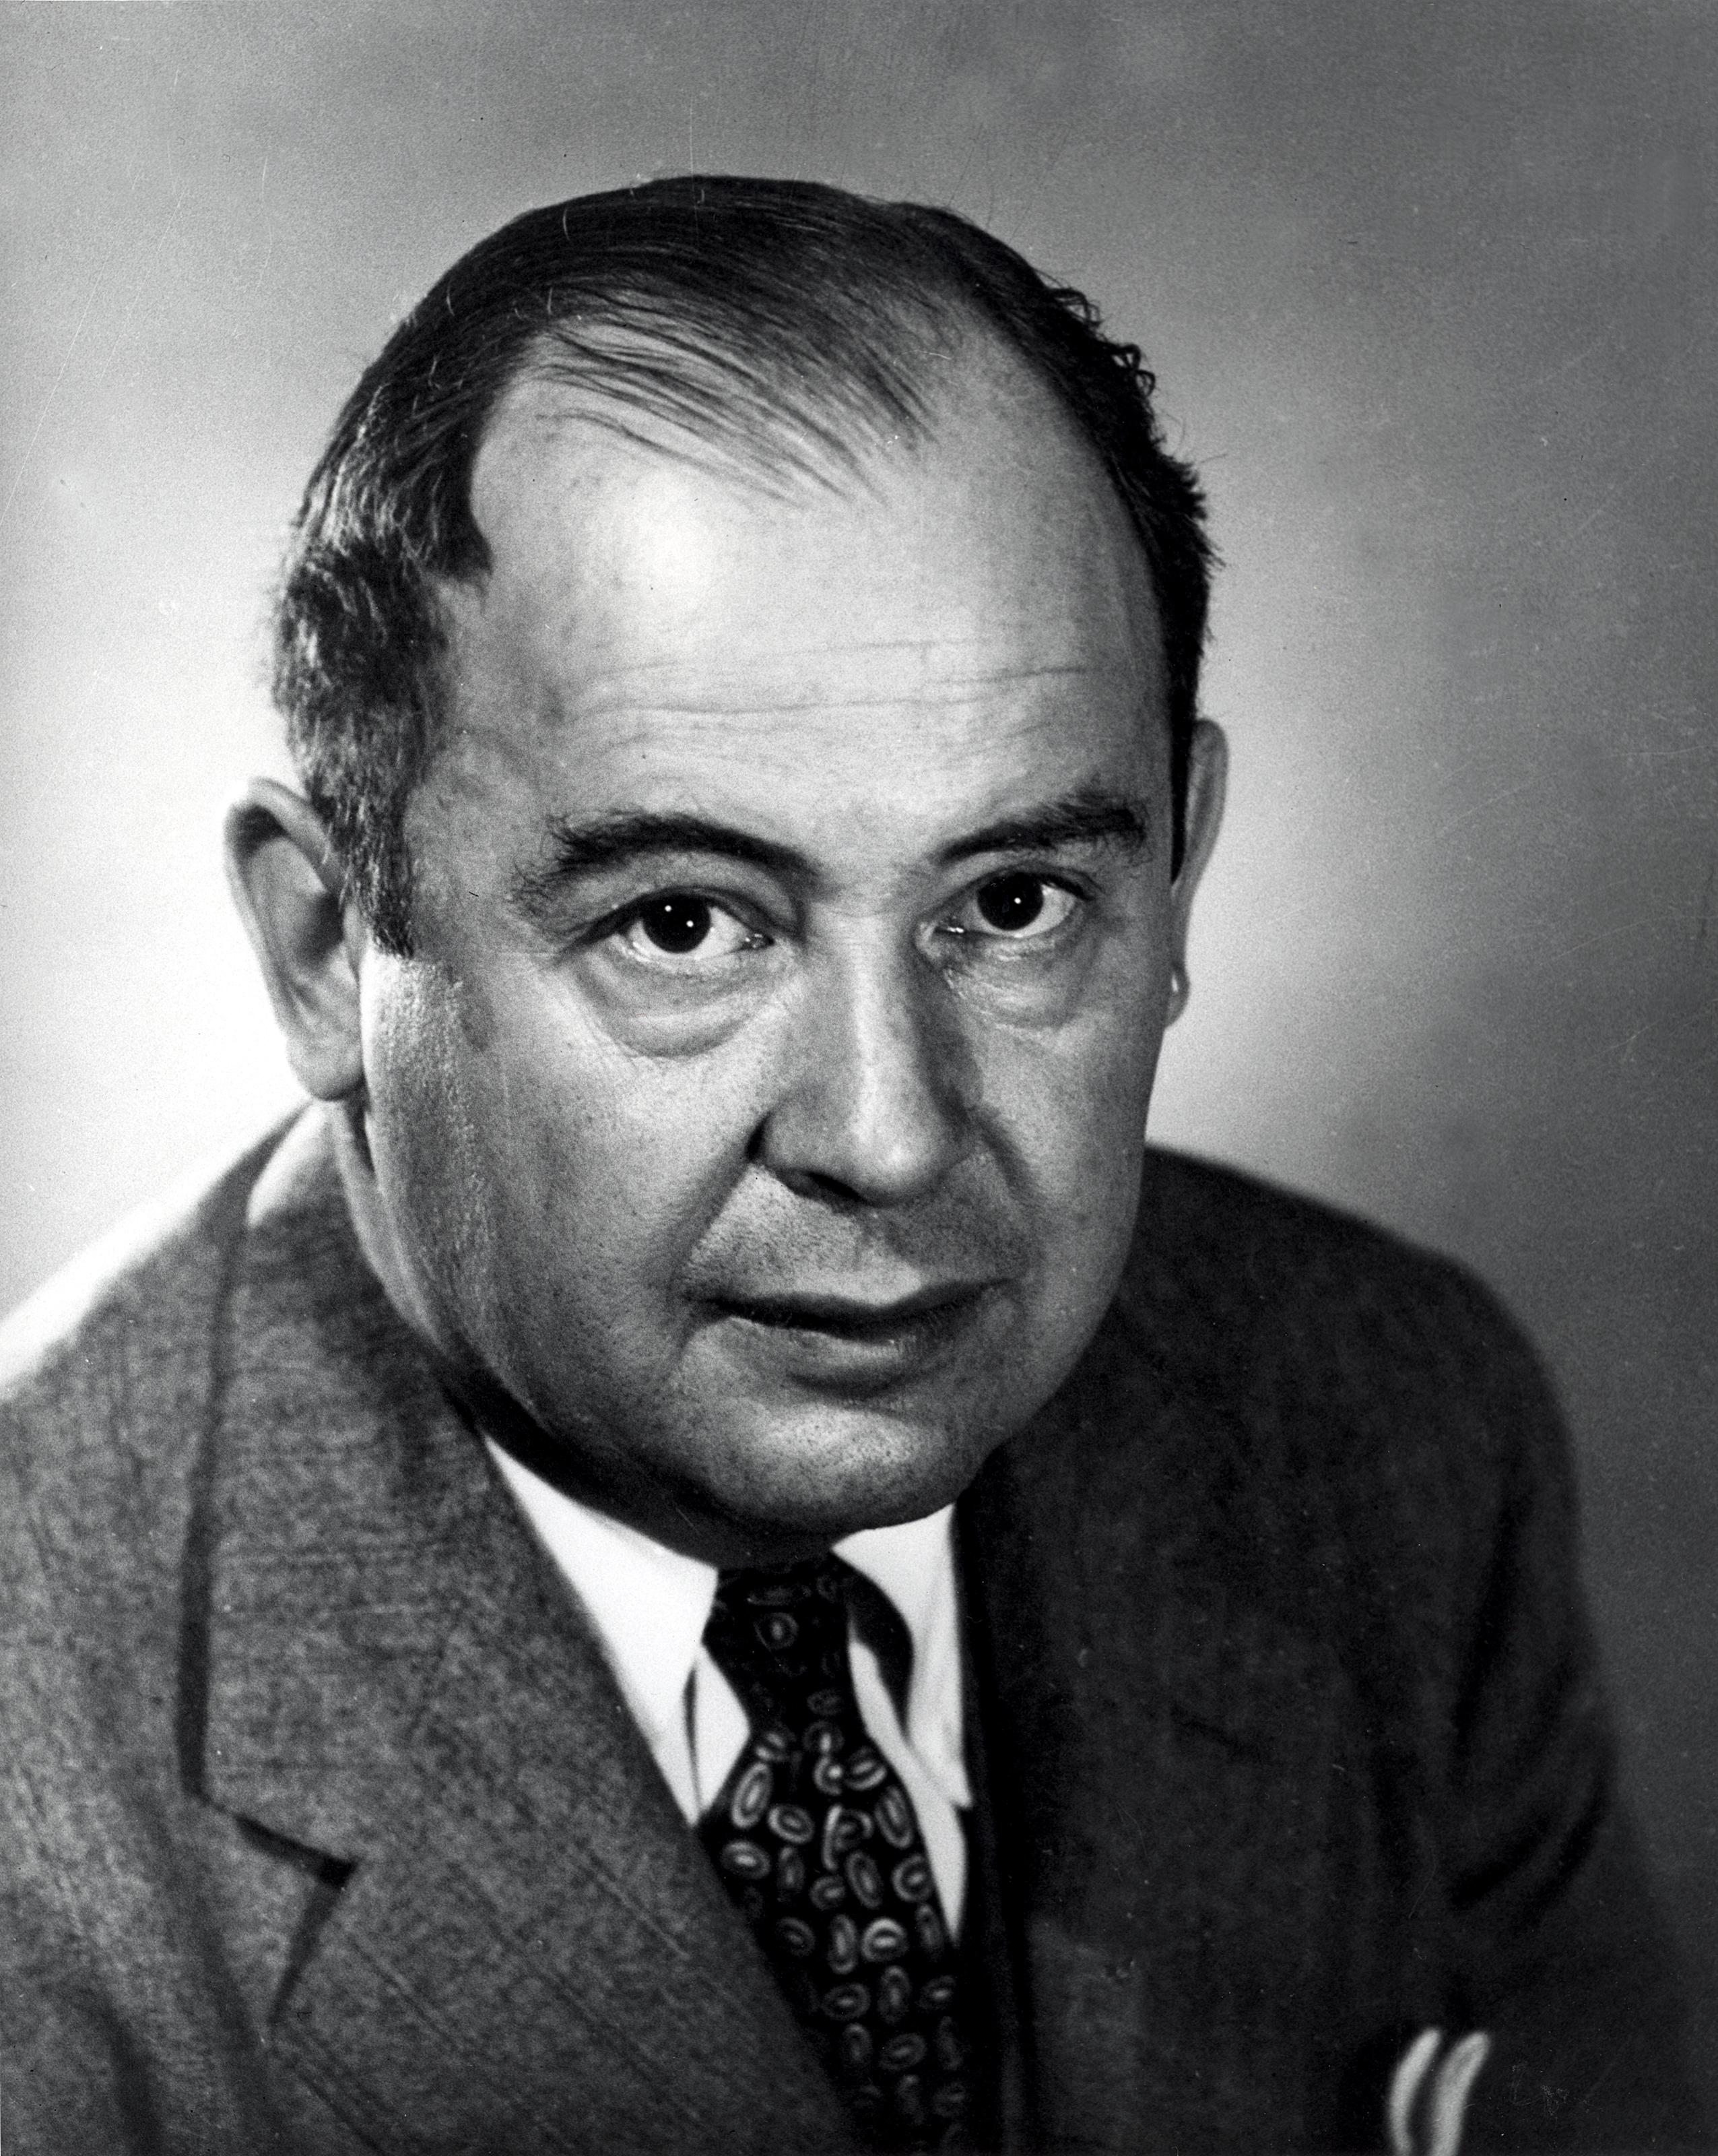
Fixed- and stored-program computers
Calculators are examples of computers – they take inputs, process them and output a result.
John von Neumann designed computers with stored programs.

Slide 3
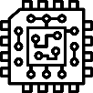

Von Neumann architecture
Central processing unit (CPU)
Main memory (RAM)
Key characteristics
Central processing unit (CPU)
Control unit (CU)
Arithmetic logic unit (ALU)
Cache
Clock
Control
unit (CU)
Arithmetic logic unit (ALU)
Address | Data
1 | Load address 5
2 | Add address 6
3 | Store in address 6
4 | End
5 | 23
6 | 12
Register
Cache
Clock

Slide 4
Von Neumann architecture
Central processing unit (CPU)
Main memory (RAM)
Notice how both instruction data and program data are stored in the same memory in binary form.
Control
unit (CU)
Arithmetic logic unit (ALU)
Address | Data
1 | Load address 5
2 | Add address 6
3 | Store in address 6
4 | End
5 | 23
6 | 12
Register
Accumulator
Memory address register (MAR)
Program counter (PC)
Memory data register (MDR)
Cache
Clock

Slide 5
Von Neumann architecture
Central processing unit (CPU)
Main memory (RAM)
Notice how both instruction data and program data are stored in the same memory in binary form.
Control
unit (CU)
Arithmetic logic unit (ALU)
Address | Data
1 | Load address 5
2 | Add address 6
3 | Store in address 6
4 | End
5 | 23
6 | 12
Register
Accumulator
Memory address register (MAR)
Program counter (PC)
Memory data register (MDR)
Cache
Clock

Slide 6
Von Neumann architecture
Central processing unit (CPU)
Main memory (RAM)
Program counter (PC)
Holds the address of the next instruction to be executed in memory.
Control
unit (CU)
Arithmetic logic unit (ALU)
Address | Data
1 | Load address 5
2 | Add address 6
3 | Store in address 6
4 | End
5 | 23
6 | 12
Register
Accumulator
Memory address register (MAR)
Program counter (PC)
Memory data register (MDR)
Cache
Clock

Slide 7
Von Neumann architecture
Central processing unit (CPU)
Main memory (RAM)
Memory address register (MAR)
Holds the memory address where data is to be fetched from or written to.
Control
unit (CU)
Arithmetic logic unit (ALU)
Address | Data
1 | Load address 5
2 | Add address 6
3 | Store in address 6
4 | End
5 | 23
6 | 12
Register
Accumulator
Memory address register (MAR)
Program counter (PC)
Memory data register (MDR)
Cache
Clock

Slide 8
Von Neumann architecture
Central processing unit (CPU)
Main memory (RAM)
Memory data register (MDR)
Holds data fetched from or to be written to memory.
Control
unit (CU)
Arithmetic logic unit (ALU)
Address | Data
1 | Load address 5
2 | Add address 6
3 | Store in address 6
4 | End
5 | 23
6 | 12
Register
Accumulator
Memory address register (MAR)
Program counter (PC)
Memory data register (MDR)
Cache
Clock

Slide 9
Von Neumann architecture
Central processing unit (CPU)
Main memory (RAM)
Accumulator
Holds the results of calculations.
Control
unit (CU)
Arithmetic logic unit (ALU)
Address | Data
1 | Load address 5
2 | Add address 6
3 | Store in address 6
4 | End
5 | 23
6 | 12
Register
Accumulator
Memory address register (MAR)
Program counter (PC)
Memory data register (MDR)
Cache
Clock

Slide 10
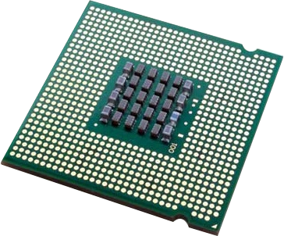
Von Neumann architecture
Central processing unit (CPU)
Main memory (RAM)
Fetch stage
The program counter is checked for the memory address of the next instruction to be executed.
Control
unit (CU)
Arithmetic logic unit (ALU)
Address | Data
1 | Load address 5
2 | Add address 6
3 | Store in address 6
4 | End
5 | 23
6 | 12
Register
Accumulator
Memory address register (MAR)
Program counter (PC)
Memory data register (MDR)
Fetch
Decode
Execute
Cache
Clock

Slide 11
Von Neumann architecture
Central processing unit (CPU)
Main memory (RAM)
Fetch stage
The program counter is checked for the memory address of the next instruction to be executed.
The memory address register (MAR) fetches the instruction from main memory (RAM) and brings it into the memory data register (MDR).
Control
unit (CU)
Arithmetic logic unit (ALU)
Address | Data
1 | Load address 5
2 | Add address 6
3 | Store in address 6
4 | End
5 | 23
6 | 12
Register
Accumulator
Memory address register (MAR)
Program counter (PC)
Memory data register (MDR)
Fetch
Decode
Execute
Cache
Clock

Slide 12
Von Neumann architecture
Central processing unit (CPU)
Main memory (RAM)
Fetch stage
The program counter is checked for the memory address of the next instruction to be executed.
The memory address register (MAR) fetches the instruction from main memory (RAM) and brings it into the memory data register (MDR).
The program counter is incremented so it points to the next instruction.
Control
unit (CU)
Arithmetic logic unit (ALU)
Address | Data
1 | Load address 5
2 | Add address 6
3 | Store in address 6
4 | End
5 | 23
6 | 12
Register
Accumulator
Memory address register (MAR)
Program counter (PC)
Memory data register (MDR)
Fetch
Decode
Execute
Cache
Clock

Slide 13
Von Neumann architecture
Central processing unit (CPU)
Main memory (RAM)
Decode stage
Now the instruction is in the CPU, the control unit (CU) decodes it to figure out what the CPU needs to do.
Control
unit (CU)
Arithmetic logic unit (ALU)
Address | Data
1 | Load address 5
2 | Add address 6
3 | Store in address 6
4 | End
5 | 23
6 | 12
Register
Accumulator
Memory address register (MAR)
Program counter (PC)
Memory data register (MDR)
Fetch
Decode
Execute
Cache
Clock

Slide 14
Von Neumann architecture
Central processing unit (CPU)
Main memory (RAM)
Execute stage
Now the CPU can execute the instruction. What it actually does depends on the instruction. It could be asked to:
Go back to main memory (RAM), fetch data and add it to the accumulator.
Jump to another instruction.
Write data held in the accumulator back into main memory (RAM).
Control
unit (CU)
Arithmetic logic unit (ALU)
Address | Data
1 | Load address 5
2 | Add address 6
3 | Store in address 6
4 | End
5 | 23
6 | 12
Register
Accumulator
Memory address register (MAR)
Program counter (PC)
Memory data register (MDR)
Fetch
Decode
Execute
Cache
Clock

Slide 15

Von Neumann architecture
The von Neumann architecture consists of a:
Control unit (CU)
Arithmetic logic unit (ALU)
Main memory (RAM)
Inputs and outputs
The von Neumann architecture is based on the stored program concept.
Both instruction data and program data are stored in the same memory in binary form. There is no way to know if the pure binary held in memory represents instructions or data simply by looking at it.
A von Neumann CPU contains the following registers:
Program counter (PC): Holds the address of the next instruction to be executed in memory.
Memory address register (MAR): Holds the memory address where data is to be fetched from or written to.
Memory data register (MDR): Holds data fetched from or to be written to memory.
Accumulator: Holds the results of calculations.

Slide 16


